Slide 1
Control Messages (ICMP)

Slide 2
Overview
Knowledge of ICMP control messages is an essential part of network troubleshooting and is a key to a full understanding of IP networks.
This module will:
Describe ICMP
Describe the ICMP message format
Identify ICMP error message types
Identify potential causes of specific ICMP error messages
Describe ICMP control messages
Identify a variety of ICMP control messages used in networks today
Determine the causes for ICMP control messages

Slide 3
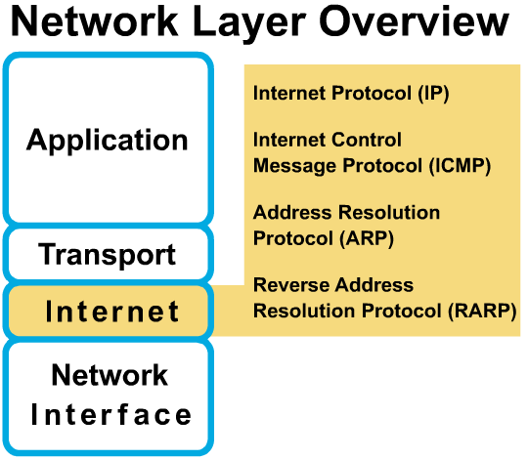
Overview
IP is a best effort delivery system.
Data may fail to reach its destination for a variety of reasons, such as hardware failure, improper configuration or incorrect routing information.
IP does not have a built-in mechanism for sending error and control messages.
IP also lack a mechanism for host and management queries.
Internet Control Message Protocol (ICMP) was designed to handle these issues.

Slide 4
ICMP
ICMP messages can be divided into categories (depending upon the author.
The Cisco curriculum divides it into:
Error-Reporting Messages
Suite Control Messages

Slide 5
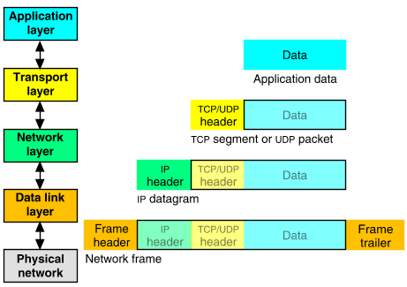
Internet Control Message Protocol (ICMP)
IP is an unreliable method for delivery of network data.
Nothing in its basic design allows IP to notify the sender that a data transmission has failed.
Internet Control Message Protocol (ICMP) is the component of the TCP/IP protocol stack that addresses this basic limitation of IP.
ICMP does not overcome the unreliability issues in IP.
Reliability must be provided by upper layer protocols (TCP or the application) if it is needed. .

Slide 6
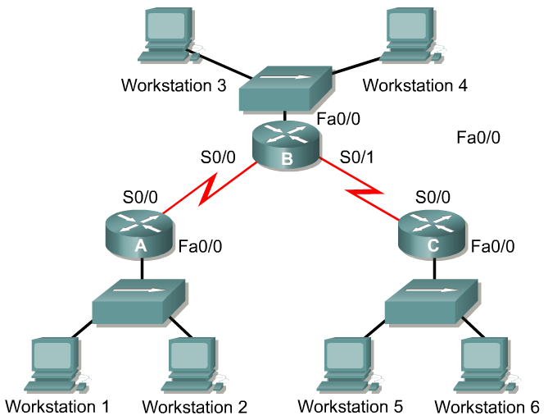
Error reporting and error correction
When datagram delivery errors occur, ICMP is used to report these errors back to the source of the datagram.
Example
ICMP msg
X
source
destination
Workstation 1 is sending a datagram to Workstation 6
Fa0/0 on Router C goes down
Router C then utilizes ICMP to send a message back to Workstation 1 indicating that the datagram could not be delivered.
ICMP does not correct the encountered network problem.
Router C knows only the source and destination IP addresses of the datagram, not know about the exact path the datagram took to Router C, therefore, Router C can only notify Workstation 1 of the failure
ICMP reports on the status of the delivered packet only to the source device.

Slide 7
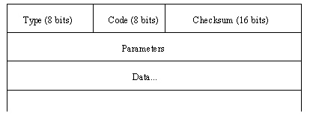
Format of an ICMP Message
http://www.iana.org/assignments/icmp-parameters
Type Field
Type Name
---- -------------------------
0 Echo Reply
1 Unassigned
2 Unassigned
3 Destination Unreachable
4 Source Quench
5 Redirect
6 Alternate Host Address
7 Unassigned
8 Echo
9 Router Advertisement
10 Router Solicitation
11 Time Exceeded
12 Parameter Problem
13 Timestamp
14 Timestamp Reply
15 Information Request
16 Information Reply
Type Name
---- -------------------------
17 Address Mask Request
18 Address Mask Reply
19 Reserved (for Security)
20-29 Reserved (for Robustness Experiment)
30 Traceroute
31 Datagram Conversion Error
32 Mobile Host Redirect
33 IPv6 Where-Are-You
34 IPv6 I-Am-Here
35 Mobile Registration Request
36 Mobile Registration Reply
37 Domain Name Request
38 Domain Name Reply
39 SKIP
40 Photuris
41-255 Reserved

Slide 8
Format of an ICMP Message
http://www.iana.org/assignments/icmp-parameters
Code Field
Many of these ICMP types have a "code" field.
Here are the assigned code fields for Type 3 Destination Unreachable.
Codes 2 and 3 are created only by the Destination Host, all others are created only by routers.
Type 3: Destination Unreachable
Codes
0 Net Unreachable
1 Host Unreachable
2 Protocol Unreachable
3 Port Unreachable
4 Fragmentation Needed and Don't Fragment was Set
5 Source Route Failed
6 Destination Network Unknown
7 Destination Host Unknown
8 Source Host Isolated
9 Communication with Destination Network is Administratively Prohibited
10 Communication with Destination Host is Administratively Prohibited
11 Destination Network Unreachable for Type of Service
12 Destination Host Unreachable for Type of Service
13 Communication Administratively Prohibited
14 Host Precedence Violation
15 Precedence cutoff in effect

Slide 9
ICMP Error Messages

Slide 10
Unreachable Destinations
Network Unreachable
generated by router lacking any route to destination
Host Unreachable
last hop router cannot contact destination
Port Unreachable
no process bound to port

Slide 11
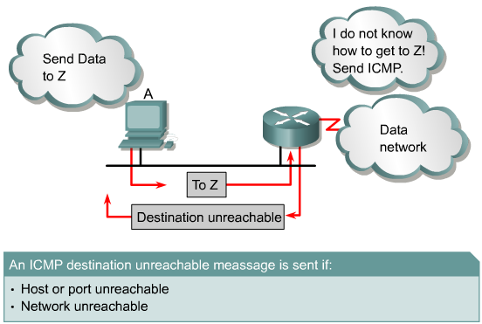
Unreachable networks
Network communication depends upon certain basic conditions being met:
Sending and receiving devices must have the TCP/IP protocol stack properly configured.
proper configuration of IP address and subnet mask.
A default gateway must also be configured if datagrams are to travel outside of the local network.
A router also must have the TCP/IP protocol properly configured on its interfaces, and it must use an appropriate routing protocol.
If these conditions are not met, then network communication cannot take place.

Slide 12
Unreachable networks
Examples of problems:
Sending device may address the datagram to a non-existent IP address
Destination device that is disconnected from its network.
Router’s connecting interface is down
Router does not have the information necessary to find the destination network.

Slide 13
Destination unreachable message
ICMP Destination Unreachable
Type = 3
If datagrams cannot always be forwarded to their destinations, ICMP delivers back to the sender a destination unreachable message indicating to the sender that the datagram could not be properly forwarded.
A destination unreachable message may also be sent when packet fragmentation is required in order to forward a packet.
Fragmentation is usually necessary when a datagram is forwarded from a Token-Ring network(4500-18000) to an Ethernet network.
If the datagram does not allow fragmentation, the packet cannot be forwarded, so a destination unreachable message will be sent.
More a little later on fragmentation and MTU Path Discovery!
Destination unreachable messages may also be generated if IP related services such as FTP or Web services are unavailable.

Slide 14
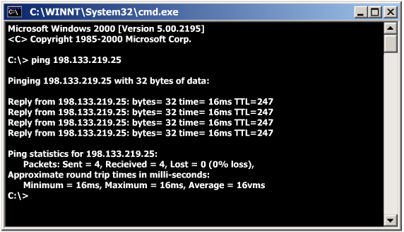
ICMP Echo (Request) and Echo Reply
Echo = Type 8
Echo Reply = Type 0
Notice that the code is 0 for both
IP Protocol Field = 1
The echo request message is typically initiated using the ping command .

Slide 15

For more information on Ping
Here are two options for more information on Ping:
See PowerPoint presentation: ICMP – Understanding Ping and Trace
Read the book: The Story About Ping by Marjorie Flack, Kurt Wiese

Slide 16
Detecting excessively long routes
ICMP Time Exceeded
Type = 11
A TTL value is defined in each datagram (IP packet).
As each router processes the datagram, it decreases the TTL value by one.
When the TTL of the datagram value reaches zero, the packet is discarded.
ICMP uses a time exceeded message to notify the source device that the TTL of the datagram has been exceeded.

Slide 17
http://www.map.meteoswiss.ch/map-doc/ftp-probleme.htm
TTL Overview - Disclaimer:
The following list is a best effort overview of some widely used TCP/IP stacks. The information was provided by vendors and many helpful system administrators. We would like to thank all these contributors for their precious help ! SWITCH cannot, however, take any responsibility that the provided information is correct. Furthermore, SWITCH cannot be made liable for any damage that may arise by the use of this information.
+--------------------+-------+---------+---------+
| OS Version |"safe" | tcp_ttl | udp_ttl |
+--------------------+-------+---------+---------+
AIX n 60 30
DEC Pathworks V5 n 30 30
FreeBSD 2.1R y 64 64
HP/UX 9.0x n 30 30
HP/UX 10.01 y 64 64
Irix 5.3 y 60 60
Irix 6.x y 60 60
Linux y 64 64
MacOS/MacTCP 2.0.x y 60 60
OS/2 TCP/IP 3.0 y 64 64
OSF/1 V3.2A n 60 30
Solaris 2.x y 255 255
SunOS 4.1.3/4.1.4 y 60 60
Ultrix V4.1/V4.2A n 60 30
VMS/Multinet y 64 64
VMS/TCPware y 60 64
VMS/Wollongong 1.1.1.1 n 128 30
VMS/UCX (latest rel.) y 128 128
MS WfW n 32 32
MS Windows 95 n 32 32
MS Windows NT 3.51 n 32 32
MS Windows NT 4.0 y 128 128
Assigned Numbers (RFC 1700, J. Reynolds, J. Postel, October 1994):
IP TIME TO LIVE PARAMETER
The current recommended default time to live (TTL) for the Internet Protocol (IP) is 64.
Safe: TCP and UDP initial TTL values should be set to a "safe" value of at least 60 today.

Slide 18
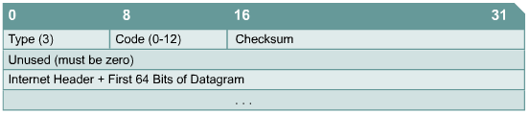
IP Parameter Problem
ICMP Parameter Problem
Type = 12
Devices that process datagrams may not be able to forward a datagram due to some type of error in the header.
This error does not relate to the state of the destination host or network but still prevents the datagram from being processed and delivered.
An ICMP type 12 parameter problem message is sent to the source of the datagram.

Slide 19
ICMP Control Messages

Slide 20
Introduction to ICMP Control Messages
Unlike error messages, control messages are not the results of lost packets or error conditions which occur during packet transmission.
Instead, they are used to inform hosts of conditions such as:
Network congestion
Existence of a better gateway to a remote network

Slide 21
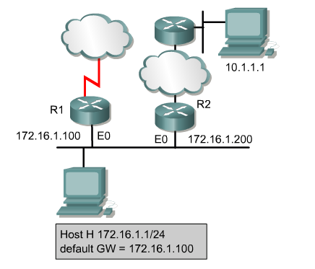
ICMP Redirect
3
ICMP Redirect
2
Type = 5 Code = 0 to 3
1
2
4
ICMP Redirect messages can only be sent by routers
Host H sends a packet to Host 10.1.1.1 on network 10.0.0.0/8.
Since Host H is not directly connected to the same network, it forwards the packet to its default gateway, Router R1 at 172.16.1.100.
Router R1 finds the correct route to network 10.0.0.0/8 by looking in its route table.
It determines that the path to the network is back out the same interface the request to forward the packet came from to Router R2 at 172.16.1.200.
R1 forwards the packet to R2 and sends an ICMP redirect/change request to Host H telling it to use Router R2 at 172.16.1.100 as the gateway to forward all future requests to network 10.0.0.0/8.

Slide 22
ICMP Redirects
ICMP Redirect
Type = 5 Code = 0 to 3
Default gateways only send ICMP redirect/change request messages if the following conditions are met:
The interface on which the packet comes into the router is the same interface on which the packet gets routed out.
The subnet/network of the source IP address is the same subnet/network of the next-hop IP address of the routed packet.
The datagram is not source-routed.
The route for the redirect is not another ICMP redirect or a default route.
The router is configured to send redirects. (By default, Cisco routers send ICMP redirects. The interface subcommand no ip redirects will disable ICMP redirects.)

Slide 23

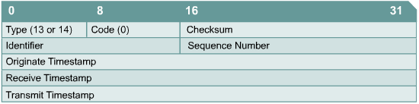
Clock synchronization and transit time estimation
Replaced by
ICMP Timestamp Request
Type = 13 or 14
The TCP/IP protocol suite allows systems to connect to one another over vast distances through multiple networks.
Each of these individual networks provides clock synchronization in its own way.
As a result, hosts on different networks who are trying to communicate using software that requires time synchronization can sometimes encounter problems.
The ICMP timestamp message type is designed to help alleviate this problem.
The ICMP timestamp request message allows a host to ask for the current time according to the remote host.
The remote host uses an ICMP timestamp reply message to respond to the request.

Slide 24
Clock synchronization and transit time estimation
Replaced by
ICMP Timestamp
Type = 13 or 14
All ICMP timestamp reply messages contain the originate, receive and transmit timestamps.
Using these three timestamps, the host can estimate transit time across the network by subtracting the originate time from the transit time.
It is only an estimate however, as true transit time can vary widely based on traffic and congestion on the network.
The host that originated the timestamp request can also estimate the local time on the remote computer.
While ICMP timestamp messages provide a simple way to estimate time on a remote host and total network transit time, this is not the best way to obtain this information.
Instead, more robust protocols such as Network Time Protocol (NTP) at the upper layers of the TCP/IP protocol stack perform clock synchronization in a more reliable manner.

Slide 25
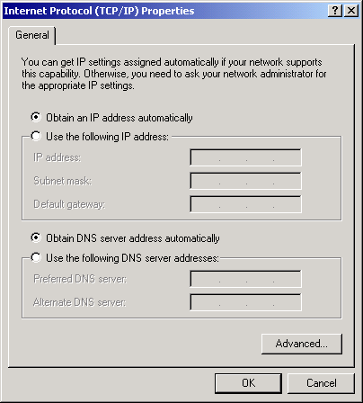
Information requests and reply message formats
ICMP Information Request/Reply
Type = 15 or 16
Replaced by
The ICMP information requests and reply messages were originally intended to allow a host to determine its network number.
This particular ICMP message type is considered obsolete.
Other protocols such as BOOTP and Dynamic Host Configuration Protocol (DHCP) are now used to allow hosts to obtain their network numbers.

Slide 26
Address Masks
ICMP Address Mask Request/Reply
Type = 17 or 18
This new subnet mask is crucial in identifying network, subnet, and host bits in an IP address.
If a host does not know the subnet mask, it may send an address mask request to the local router.
If the address of the router is known, this request may be sent directly to the router.
Otherwise, the request will be broadcast.
When the router receives the request, it will respond with an address mask reply.
Somewhat obsolete, was used with diskless workstations that used RARP for the IP address and ICMP for the subnet mask.
Replaced by

Slide 27
Router Solicitation and Advertisement
ICMP Router Solicitation
Type = 10
ICMP Router Advertisement
Type = 9
Replaced by
When a host on the network boots, and the host has not been manually configured with a default gateway, it can learn of available routers through the process of router discovery.
This process begins with the host sending a router solicitation message to all routers, using the multicast address 224.0.0.2 as the destination address. (May also be broadcast).
When a router that supports the discovery process receives the router discovery message, a router advertisement is sent in return.
Routers may also periodically advertise router advertisement messages.

Slide 28
IRDP
Some newer IP hosts use ICMP Router Discovery Protocol (IRDP) (RFC 1256 ) to find a new router when a route becomes unavailable.
A host that runs IRDP listens for hello multicast messages from its configured router and uses an alternate router when it no longer receives those hello messages.
The default timer values of IRDP mean that it's not suitable for detection of failure of the first hop.
The default advertisement rate is once every 7 to 10 minutes, and the default lifetime is 30 minutes.

Slide 29
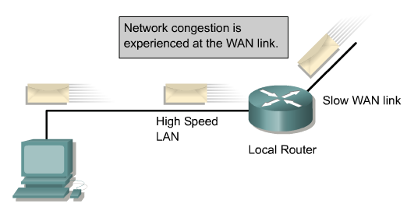
ICMP source-quench messages
ICMP Source Quench
Type = 4
Congestion can also occur for various reasons including when traffic from a high speed LAN reaches a slower WAN connection.
Dropped packets occur when there is too much congestion on a network.
ICMP source-quench messages are used to reduce the amount of data lost.
The source-quench message asks senders to reduce the rate at which they are transmitting packets.
In most cases, congestion will subside after a short period of time, and the source will slowly increase the transmission rate as long as no other source-quench messages are received.
Most Cisco routers do not send source-quench messages by default, because the source-quench message may itself add to the network congestion. (See TCP)

Slide 30
ICMP source-quench messages
ICMP Source Quench
Type = 4
IP has no mechanism for flow control
Some issues with ICMP Source Quench:
A router or destination host (buffers full) will send one source-quench message for each discarded packet.
No mechanism to tell the source that the congestion has been relieved and source can resume sending at previous rate.
Remember, TCP/IP uses TCP mechanisms for flow control and reliability including sliding windows.

Slide 31
ICMP Path MTU Discovery

Slide 32
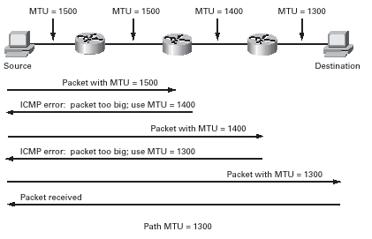
Path MTU Discovery
Problem:
How path MTU discovery (PMTU-D) combined with filtering ICMP messages can result in connectivity problems.
Path MTU discovery allows a node to dynamically discover and adjust to differences in the MTU size of every link along a given data path.
In IPv4, the minimum link MTU size is 68 octets and the recommended minimum is 576 octets, which is the minimum reassembly buffer size.
So, any IPv4 packet must be at least 68 octets in length.
(In IPv6, the minimum link MTU is 1280 octets, but the recommended MTU value for IPv6 links is 1500 octets. The maximum packet size supported by the basic IPv6 header is 64,000 octets. Larger packets called jumbograms could be handled using a hop-by-hop extension header option.)

Slide 33
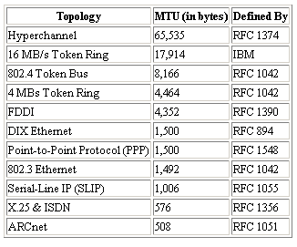

Path MTU Discovery - Terms
MTU: The maximum transmission unit is a link layer restriction on the maximum number of bytes of data in a single transmission (ie. frame, cell, packet, depending on the terminology).
The table above shows some typical values for MTUs, taken from RFC-1191.
Path MTU : The smallest MTU of any link on the current path between two hosts.
This may change over time since the route between two hosts, especially on the Internet, may change over time.
It is not necessarily symmetric and can even vary for different types of traffic from the same host.

Slide 34
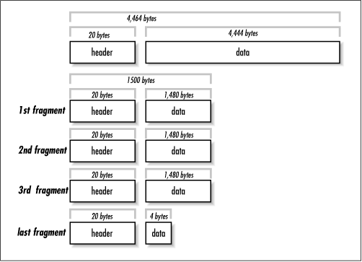
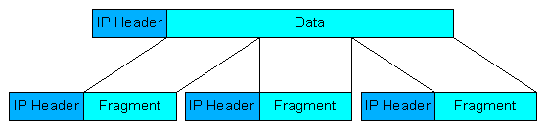
Terms
Fragmentation: When a packet is too large to be sent across a link as a single unit, a router can fragment the packet.
This means that it splits it into multiple parts which contain enough information for the receiver to glue them together again.
Note that this is not done on a hop-by-hop basis, but once fragmented a packet will not be put back together until it reaches its destination.
Fragmentation is undesirable for numerous reasons, including:
If any one fragment from a packet is dropped, the entire packet needs to be retransmitted. This is a very significant problem.
It imposes extra processing load on the routers that have to split the packets.
In some configuration, simpler firewalls will block all fragments because they don't contain the header information for a higher layer protocol (eg. TCP) needed for filtering.

Slide 35
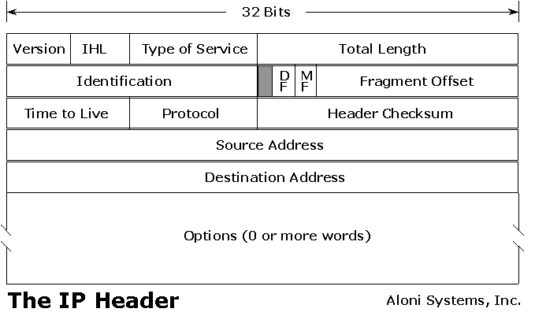
Terms
3
4
ICMP Destination Unreachable Fragmentation needed, but DF Set
DF (Don't Fragment) bit: This is a bit in the IP header that can be set to indicate that the packet should not be fragmented by routers.
If the packet needs to be fragmented, an ICMP "can't fragment" error is returned sent to the sender and the packet is dropped.
ICMP Can't Fragment Error:
This error is a type 3 (destination unreachable), code 4 (fragmentation needed but don't-fragment bit set)
Returned by a router when it receives a packet that is too large for it to forward and the DF bit is set.
The packet is dropped and the ICMP error is sent back to the origin host.
Normally, this tells the origin host that it needs to reduce the size of its packets if it wants to get through.
Recent systems also include the MTU of the next hop in the ICMP message so the source knows how big its packets can be.
Note that this error is only sent if the DF bit is set; otherwise, packets are just fragmented and passed through.

Slide 36
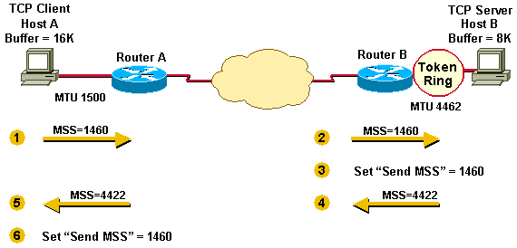
Terms
MSS: The MSS is the maximum segment size.
It can be announced during the establishment of a TCP connection to indicate to the other end the largest amount of data in one packet that should be sent by the remote system.
MSS is beyond the scope of this discussion at the moment.

Slide 37
Path MTU Discovery (PMTU-D)
Now you know that Path MTUs vary.
You know that fragmentation is bad.
The solution?
Well, one solution is Path MTU Discovery.
The idea behind it is to send packets that are as large as possible while still avoiding fragmentation.

Slide 38
PMTU-D
A host does this by starting by sending packets that have a maximum size of the lesser of the local MTU or the MSS announced by the remote system.
These packets are sent with the DF bit set.
If there is some MTU between the two hosts which is too small to pass the packet successfully, then an ICMP can't fragment error will be sent back to the source.
It will then know to lower the size; if the ICMP message includes the next hop MTU, it can pick the correct size for that link immediately, otherwise it has to guess.

Slide 39
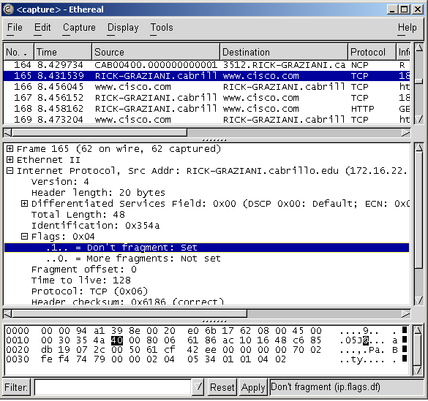
PMTU-D
The exact process that systems go through is somewhat more complicated to account for special circumstances. See, RFC 1191.
A good indication of if a system is trying to do PMTU-D is to watch the packets it is sending with something like tcpdump or snoop and see if they have the DF bit set; if so, it is most likely trying to do PMTU-D.
Most Windows and Linux/Unix OS’s default to using PMTU-D.
Adjusting IP MTU, TCP MSS, and PMTUD on Windows and Sun Systems - http://www.cisco.com/warp/public/105/38.shtml

Slide 40
The problem with ICMP filtering and PMTU-D
Many network administrators have decided to filter ICMP at a router or firewall.
There are valid (and many invalid) reasons for doing this, however it can cause problems.
ICMP is an integral part of the Internet and can not be filtered without due consideration for the effects.
In this case, if the ICMP can't fragment errors can not get back to the source host due to a filter, the host will never know that the packets it is sending are too large.
This means it will keep trying to send the same large packet, and it will keep being dropped--silently dropped from the view of any system on the other side of the filter.
While a small handful of systems that implement PMTU-D also implement a way to detect such situations, most don't and even for those that do it has a negative impact on performance and the network.

Slide 41
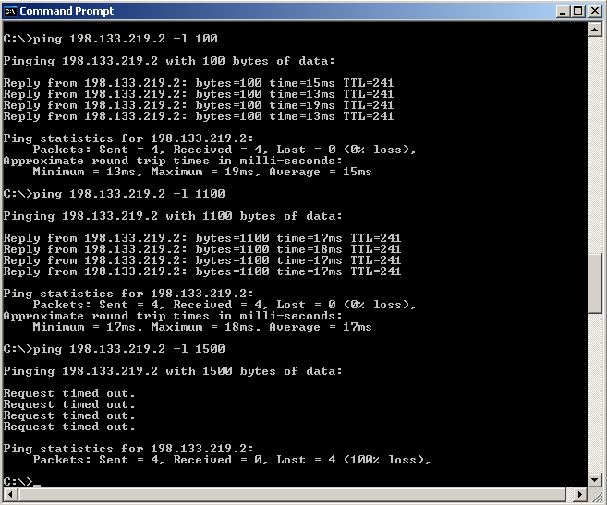
The Symptoms
If this is happening, typical symptoms include the ability for small packets (eg. request a very small web page) to get through, but larger ones (eg. a large web page) will simply hang.
This situation can be confusing to the novice administrator because they obviously have some connectivity to the host, but it just stops working for no obvious reason on certain transfers.

Slide 42
The Fix
There is one solution, and several workarounds, for this problem.
The Fix:
Fix your filters!
The real problem here is filtering ICMP messages without understanding the consequences.
Many packet filters will allow you to setup filters to only allow certain types of ICMP messages through.
If you reconfigure them to let ICMP can't fragment (type 3, code 4) messages through, the problem should disappear.
If the filter is somewhere between you and the other end, contact the administrator of that machine and try to convince them to fix the problem.
We will learn how to do this on Router Access Control Lists (ACLs)

Slide 43


Recommended Reading
Where Wizards Stay Up Late Katie Hafner and Matthew Lyon ISBN 0613181530
TCP/IP Illustrated, Vol. 1 W. Richard Stevens Addison-Wesley Pub Co ISBN: 0201633469
Very enjoyable reading and you do not have to be a networking geek to enjoy it!
National Bestseller
Although, published in 1994, written by the late Richard Stevens, it is still regarded as the definitive book on TCP/IP.

